Slide 1
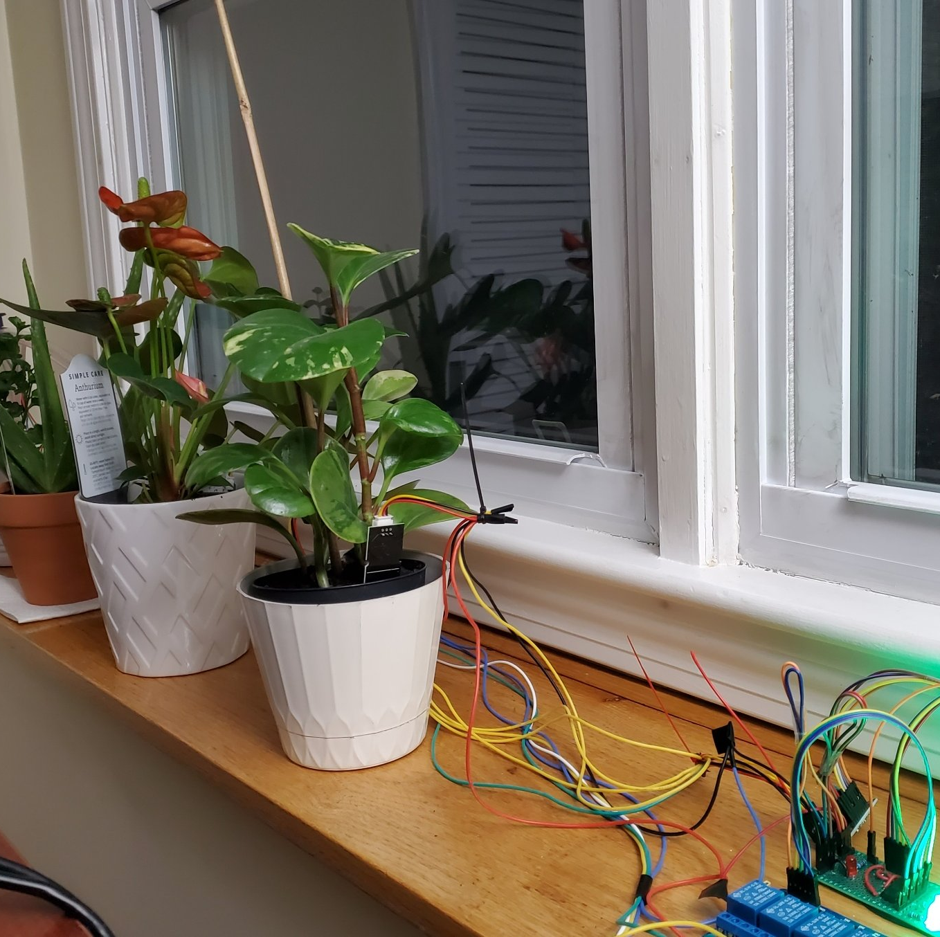
Smart Wearable device for plants
Presented By : -
Satish Kumar
Saroj Kumar
Ekhlakh Ahmad
Sonpal

Slide 2

Contents
Problem Statement
Introduction
Past Work
Block Diagram
Components Details
Circuit Diagram
Working
Why It’s Important
Advantages Of The Invention
Conclusion and Future Scope

Slide 3
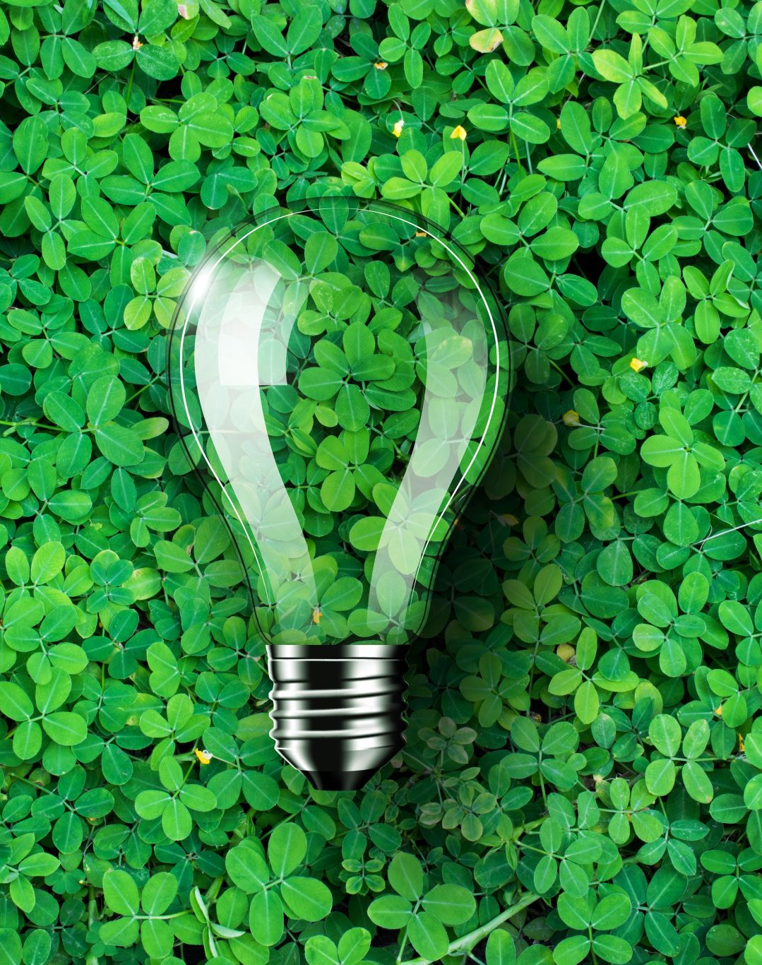
Problem Statement
In a world where technology meets agriculture, our work comes with an innovative solution: ‘Smart Wearable devices for plants’. Traditional plant care methods are often inaccurate, resulting in over or under watering and insufficient light, affecting crop yields and the environment Our project aims to solve this challenge with sensors advanced technology, real-time analytics and IoT connectivity to provide personalized care for each plant Directly Accessible through an easy-to-use mobile app, which allows plants to be monitored remotely. This innovation promises to improve plant health, increase yields, and promote sustainable agricultural and urban gardening practices, along with technology-driven solutions for plant care.

Slide 4
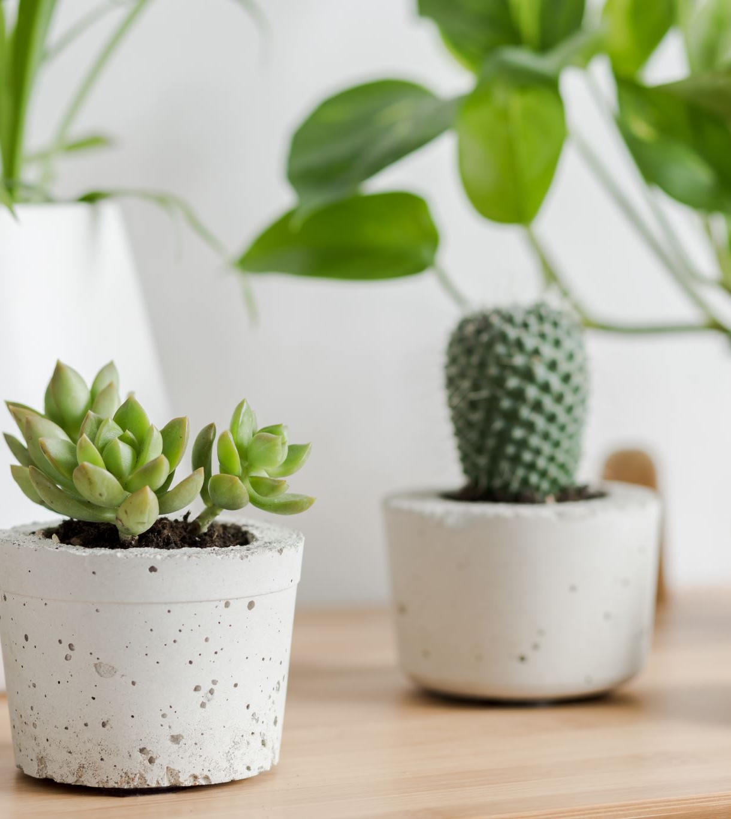
Introduction
In today's world, technology is getting smart. You know how your phone connects to the internet? Well, think about your plants doing something similar.
We're making a special gadget for them. It's like a plant's digital helper. This gadget uses smart sensors to keep an eye on things like temperature, light, and how much water the plant needs.
The best part? You can check on your plants using your phone, no matter where you are. This project isn't just about plants; it's about making our planet greener and healthier for everyone. Let's explore how technology can make taking care of plants super easy and good for the environment.

Slide 5
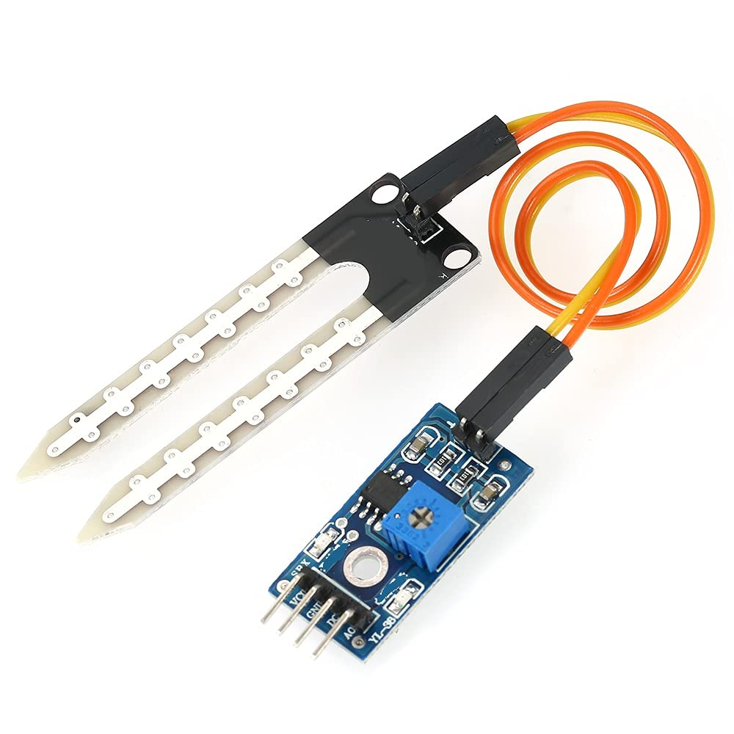
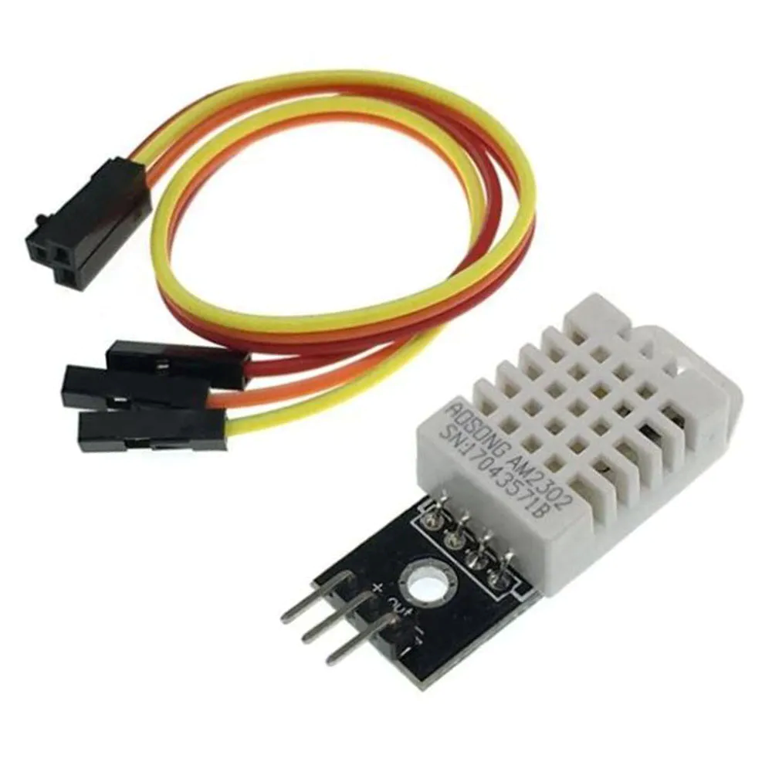

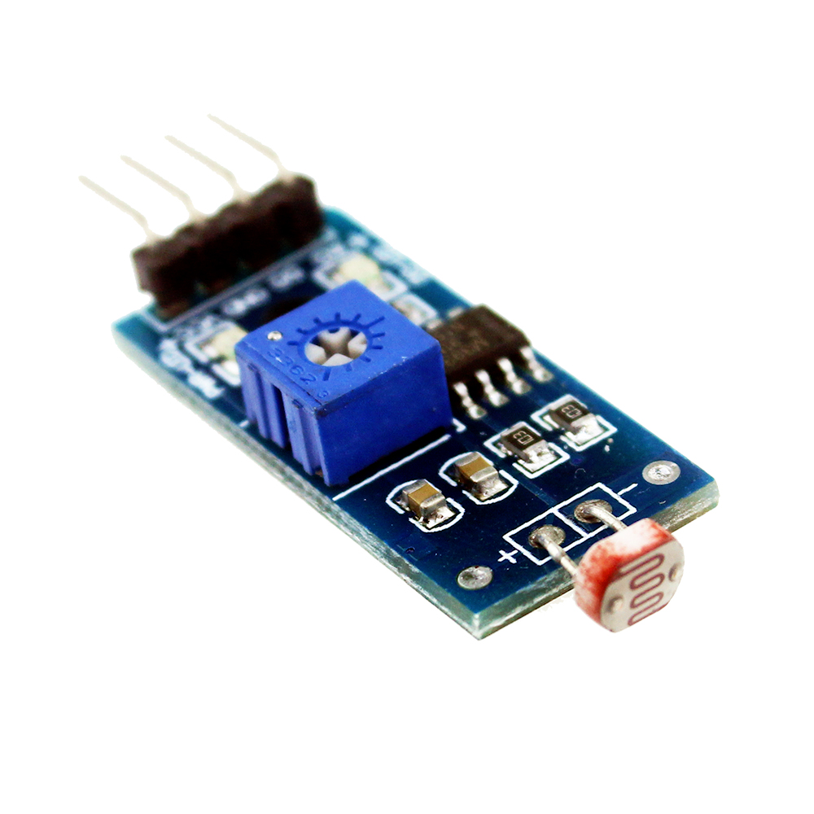
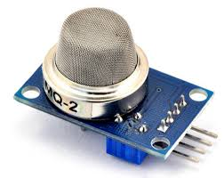
Components Used
Soil Moisture
Sensor
DHT22 Temperature and
Humidity Sensor
Arduino UNO
MQ135 Air Quality
Sensor
LDR Sensor

Slide 6
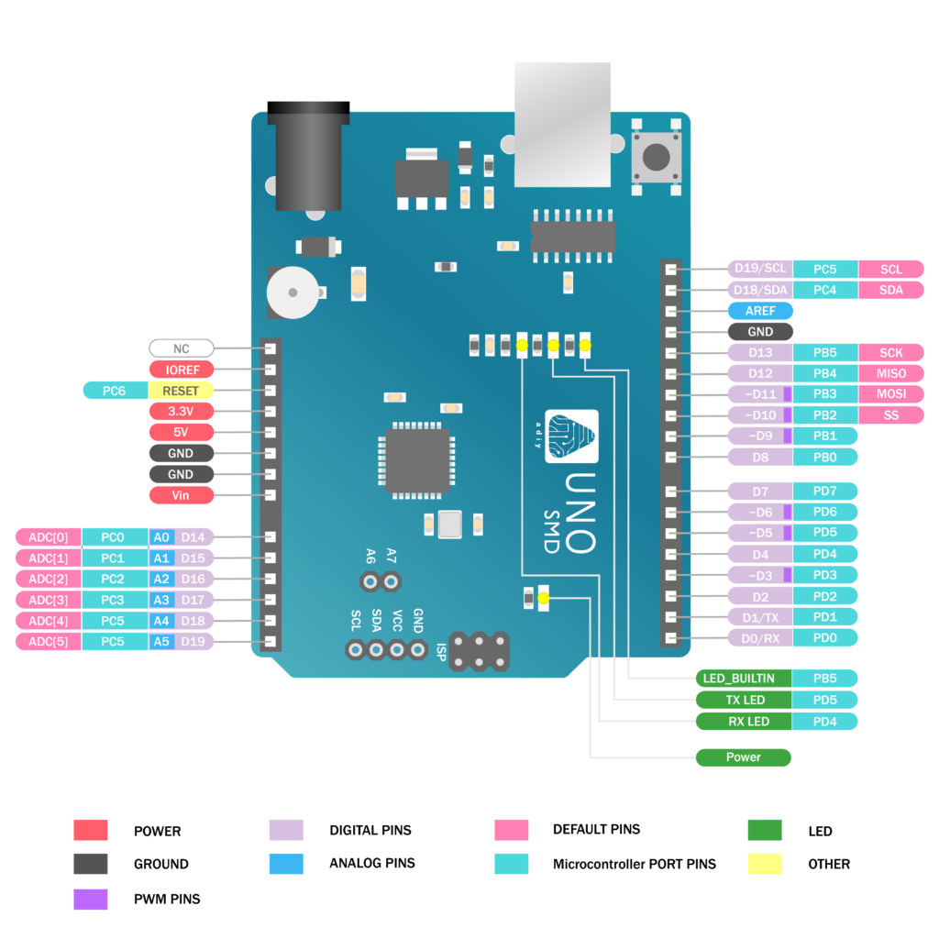
Arduino Uno
Components Details
The Arduino Uno R3 is an ATmega328P microcontroller-based development board. This is widely popular in Embedded electronics because of the available resources and easy to use by everybody features. With 14 digital input/output pins where 6 can be configured and used as PWM outputs, 6 as analog inputs is a great addition for I/O related operations. Powered with a 16 MHz ceramic resonator, an USB connection, a power jack, an ICSP header, and a reset button.

Slide 7
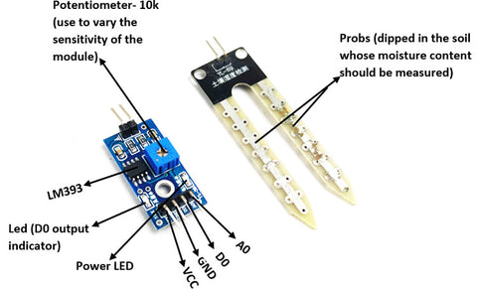
Soil moisture
Components Details
The soil moisture sensor is commonly used in smart agriculture or other garden automation projects to measure the moisture content present in the soil. It consists of 4 pins in which two pins, VCC and GND are connected to supply voltage. The remaining two pins are digital (D0) and Analog (A0) are the output pins. When the moisture content present in the soil goes beyond the threshold level, the output of the digital pin (D0) will go low (the output of the digital pin is either logic 0 or 1). The threshold value of the sensor module can be set by varying the onboard potentiometer. The Analog output pin can be used to calculate the approximate level of moisture content present in the soil.

Slide 8
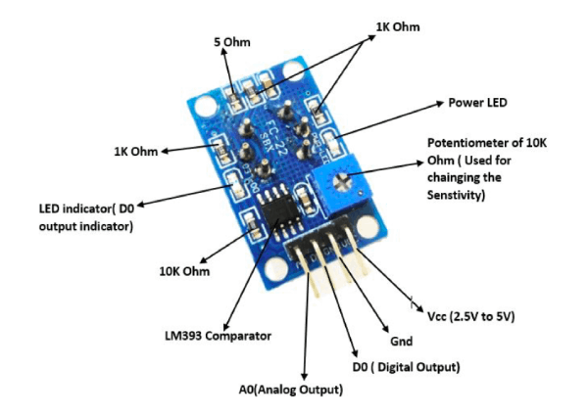
MQ135 Air Quality Sensor
Components Details
MQ-135 gas sensors are capable of detecting different gases as well as ammonia (NH_{3}), sulphur (S), Benzene (C_{6}H_{6}), CO_{2}, and toxic gases, vapours and smoke. Just like any other MQ series gas sensor, this one also has an inbuilt digital and Analog output pin. The digital pin will go in a high state when the concentration of these gases exceeds a particular acceptable level in the air. The threshold value can be preset by using the on-board potentiometer. This Analog output pin allows one to generate an analogue voltage, which is approximative to concentration of these gases into the atmosphere.

Slide 9
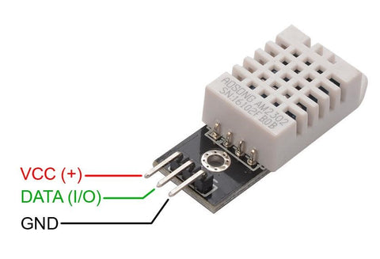
DHT22 Sensor
Components Details
A commonly used digital sensor that measures temperature and moisture is DHT22. Improved DHT22, this is a more advanced model than the previous DHT11 moisture and temperature probe. Capacitance-based moisture sensor is used by the sensor along with the thermistor-type temperature sensor for measuring moisture and temperature in the atmosphere respectively. Moisture sensing is in the range of 0% to 100 with ±1% while temperature ranging is –40°C to +80°C ±0.5°C. This sensor has a sampling time that is close to two seconds.

Slide 10
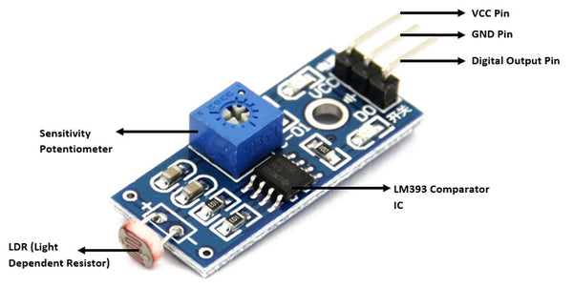
LDR Sensor
Components Details
Detecting ambient light is an important feature for many implementations such as smart street light systems, solar panel charging controllers, automatic irrigation systems in which the ambient light along with Moisture decide whether it is necessary to irrigate the planet. We typically employ LDR as we consider in the quantity of light that lands of it and thus, we have an approximate understanding on the environment’s brightness. However, there are other situations when we need to find out that the light exceeds specific level so as certain processes could take place. One of such modules that provide digital output as well as adjustable with the internal potentiometer is Photosensitive Light Detection sensor module. The device comes along with inbuilt LM393 comparator IC which helps to turn Analog Signals emerging from LDR into digital ones for linking up with the microcontroller of our choice.

Slide 11
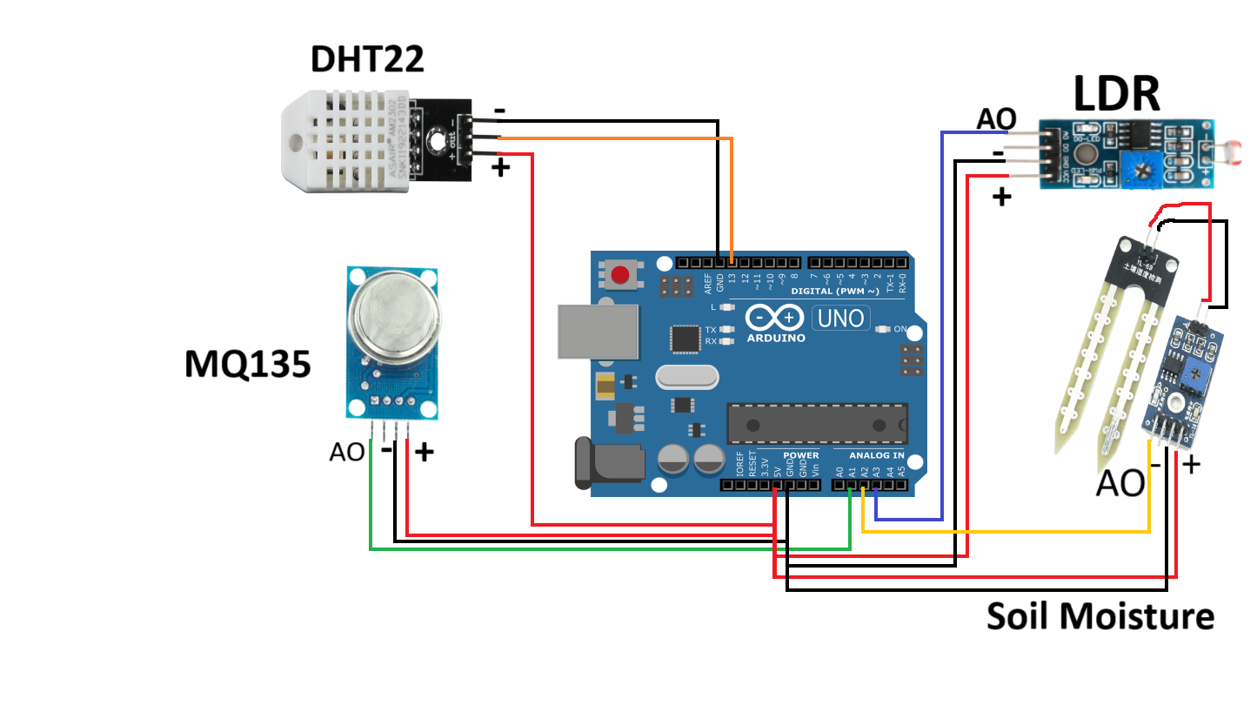
Circuit Diagram

Slide 12
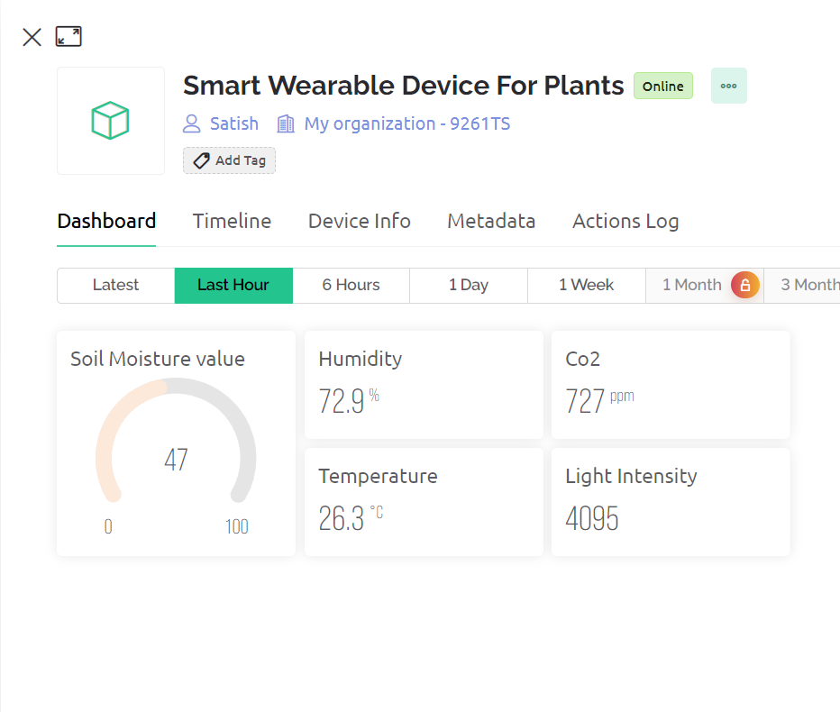
Working
Sensor Integration: The main part of the control system is its set of sensors that includes water moisture sensors, CO2 sensors, thermos and hygroscopic ones, and LDR.G The wearable device is equipped with sensors that enable simultaneous measurements of key plant parameters.
Online Integration: This way, the user can connect it with online services such as Blynk or thing speak and get all relevant information about his/her plants from any location that has access to the Internet. The online integration makes the device easier to use because its accessible.
User Interface: It has an understandable and simple design that is often available as a smartphone app or an online site. This interface enables users to look at real time readings from the sensors; it also allows them to input threshold values and get alerts.

Slide 13
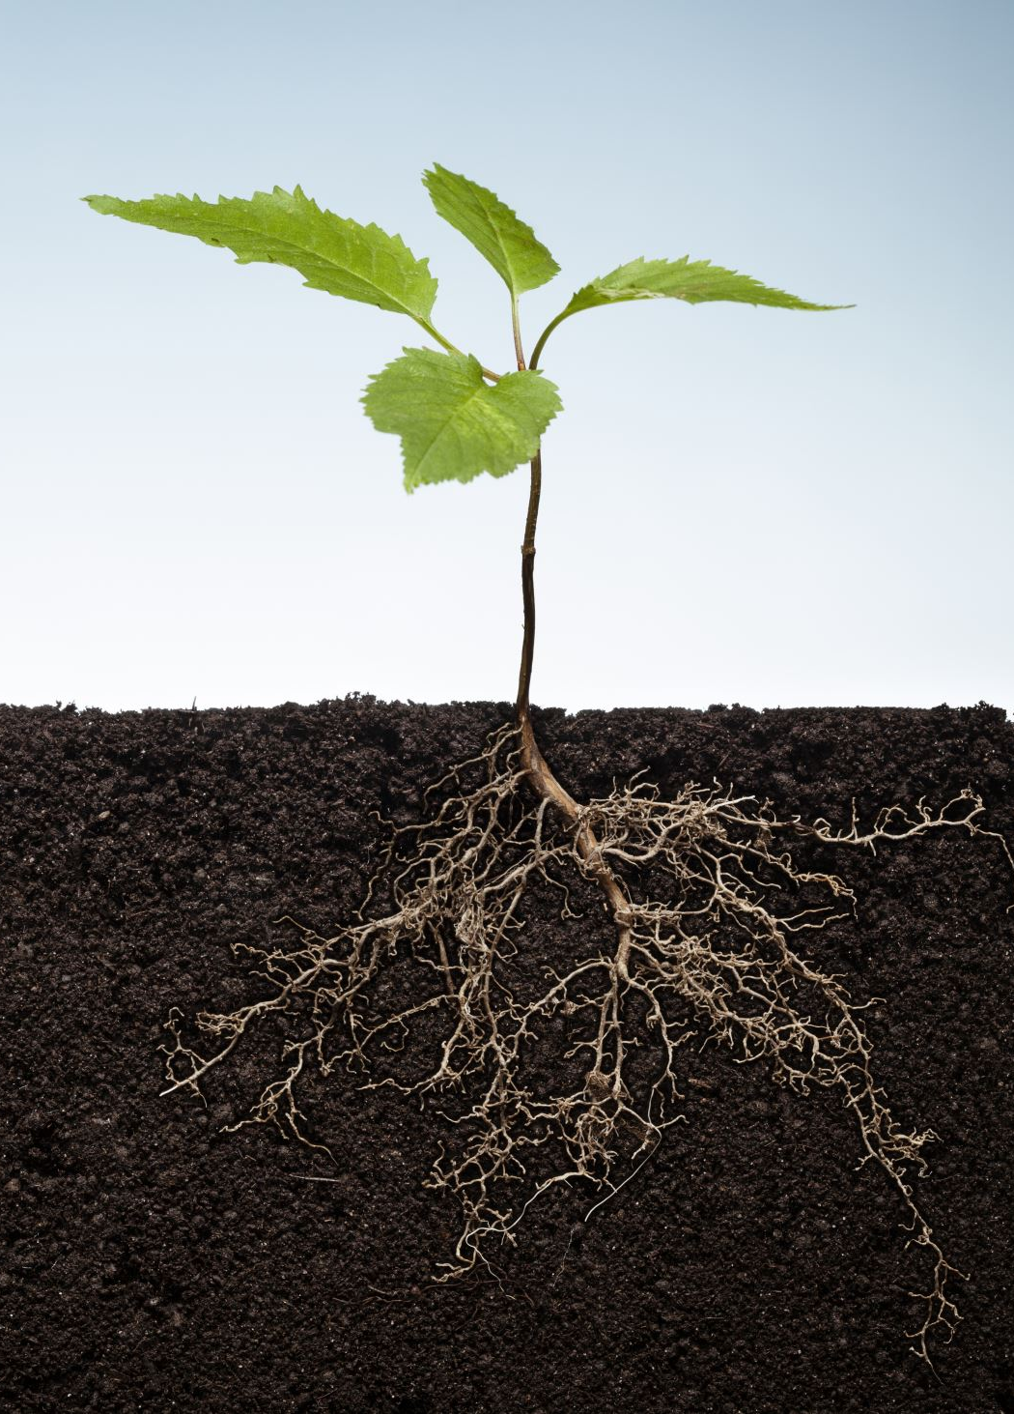
Why It's Important
Why are we doing this? Because plants are vital. They give us clean air and tasty food. But sometimes, taking care of them can be a bit tricky. Our smart plant gadget is like a plant superhero.
It makes sure they get just the right amount of sunlight, water, and care. And when it does that, it's not only making your life easier but also helping the environment. Our project is a small step towards a world with more greenery and sustainability, making it a better place for all of us.

Slide 14
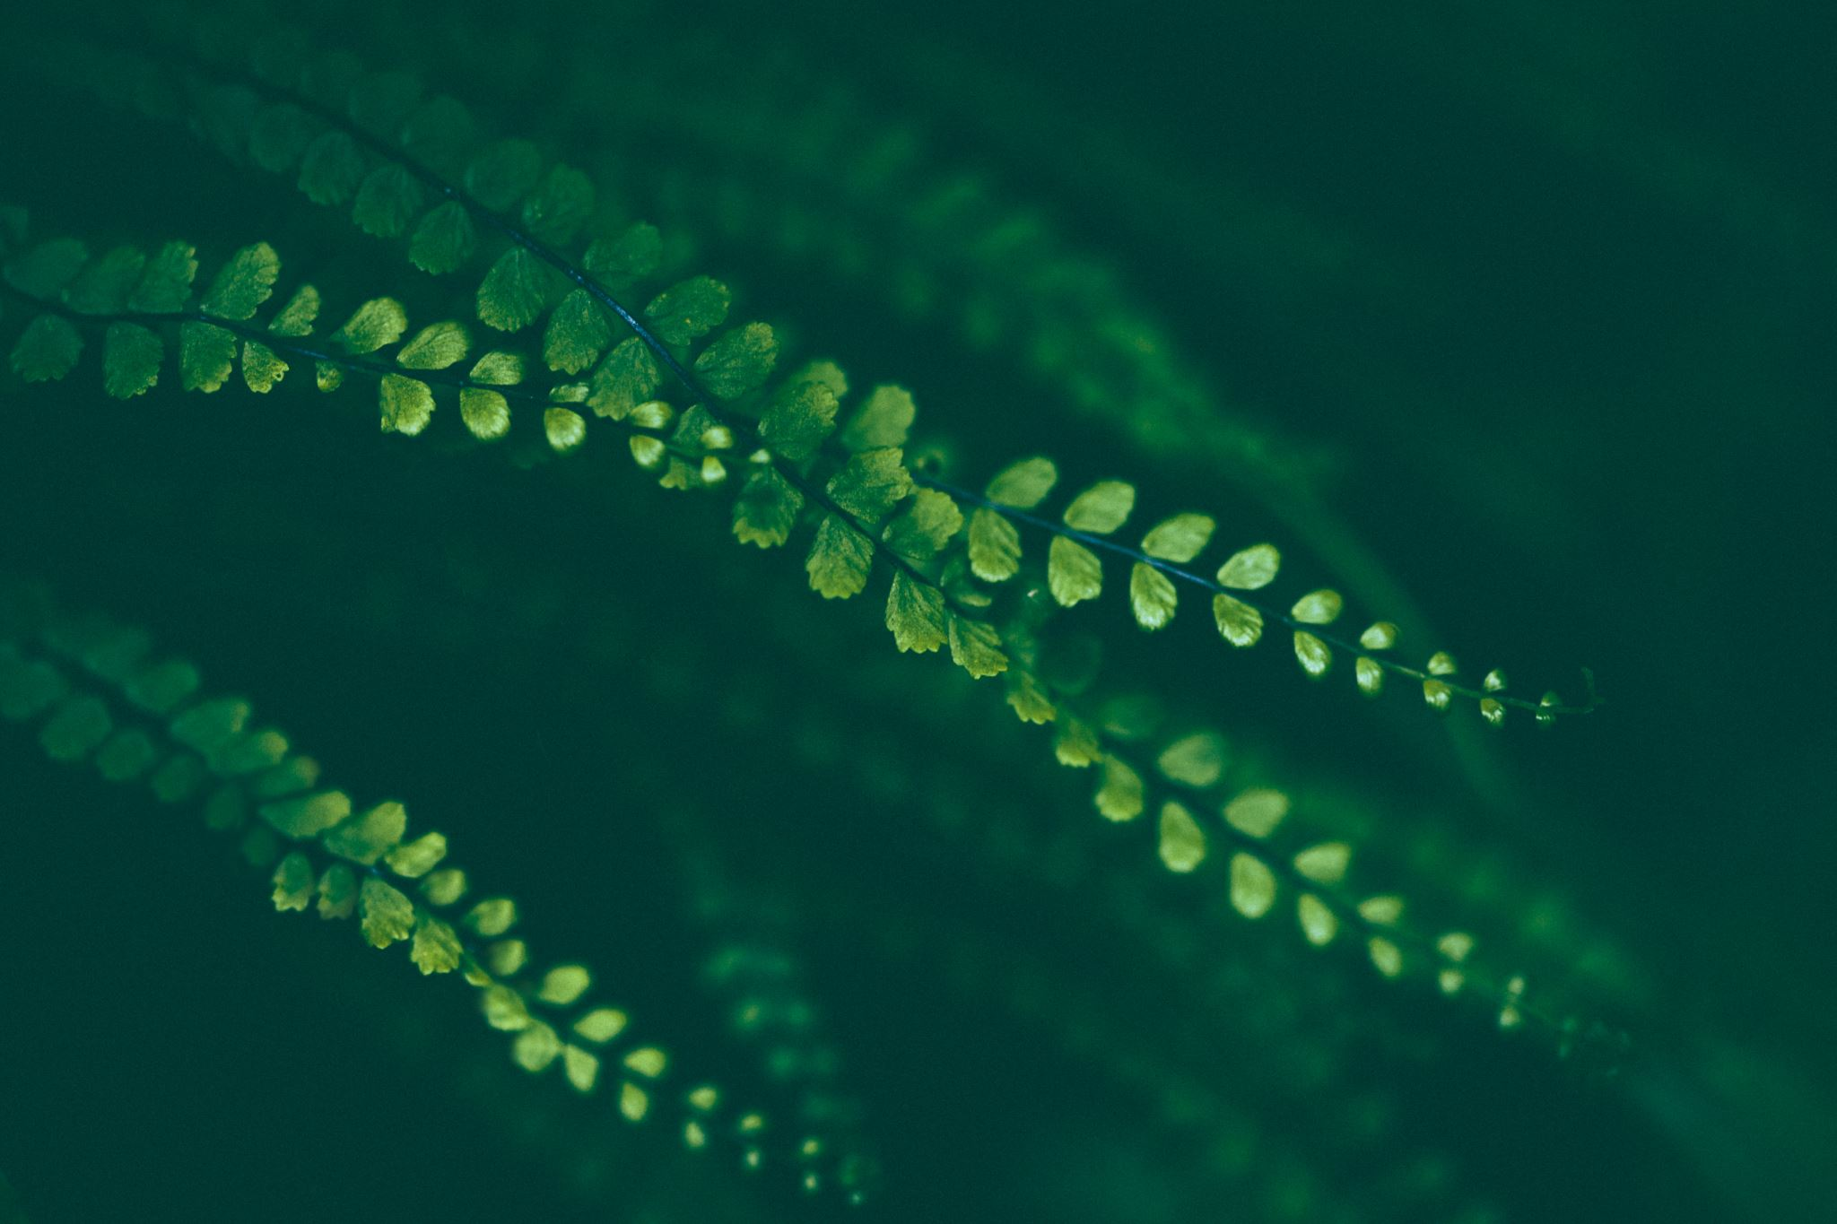
ADVANTAGES OF THE INVENTION
Low-cost: The device is made using inexpensive components, making it affordable for a wide range of consumers.
Wearable: The device is small and lightweight, so it can be easily attached to a plant's stem. This makes it ideal for monitoring plants in both indoor and outdoor settings.
Real-time data collection: The device can collect data on plant health in real time. This allows users to quickly identify and address any problems.
Easy to use: The device is easy to use and requires no technical expertise. Users can simply attach the device to the plant and start monitoring.

Slide 15
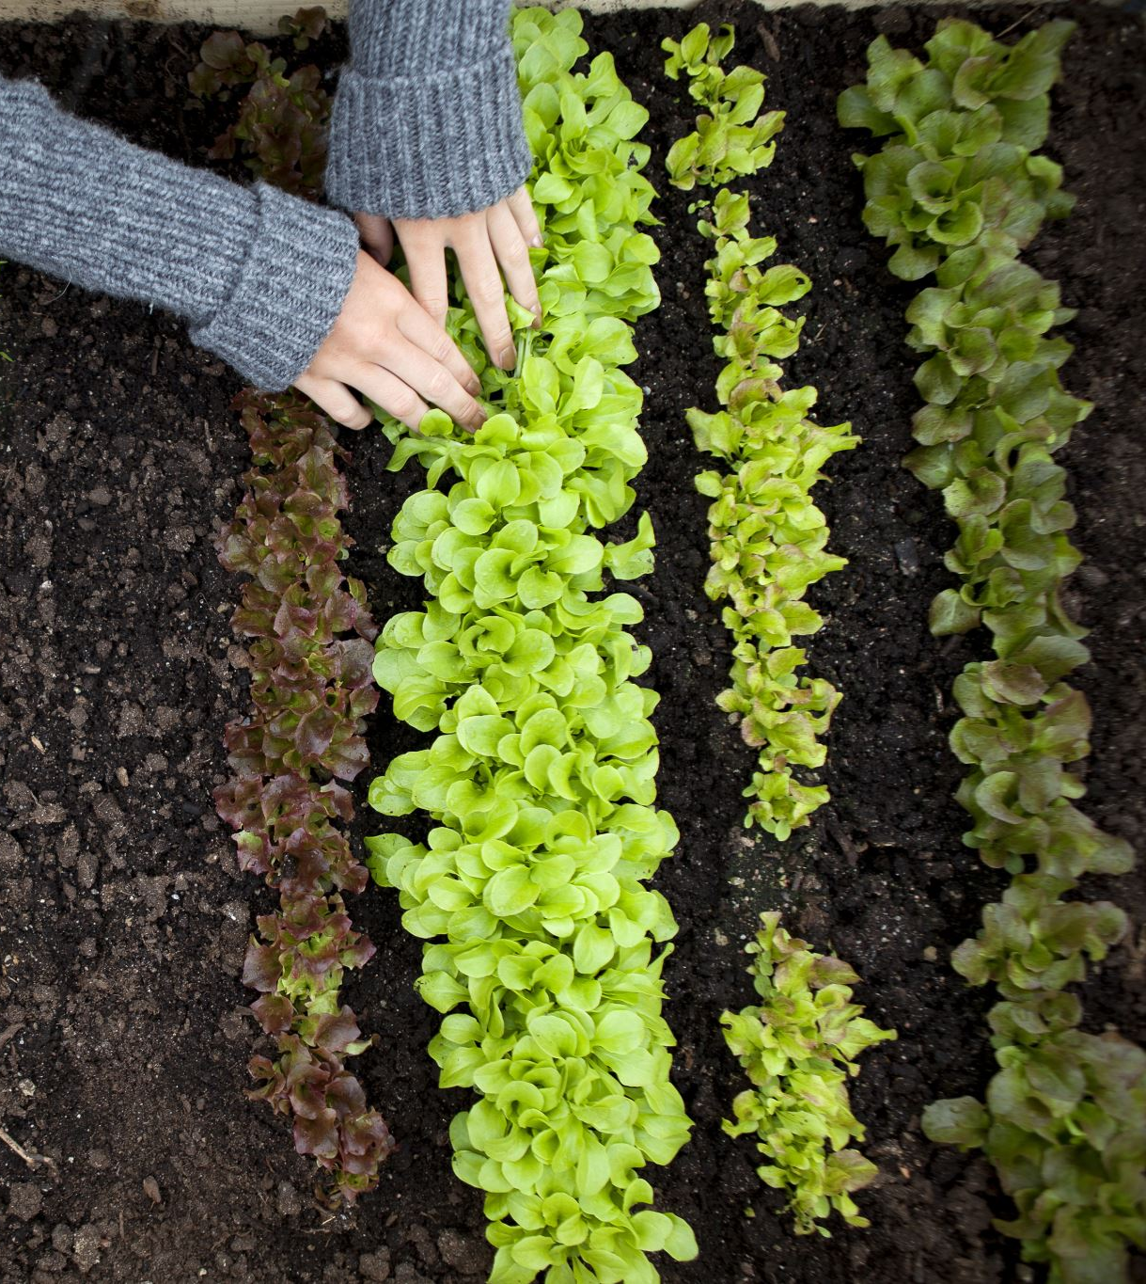
Conclusion
Farmers are using smart wearable devices to monitor the moisture levels in their soil, which helps them to avoid over-irrigation.
Growers are using smart wearable devices to track the temperature and humidity in their greenhouses, which helps them to ensure optimal growing conditions.
Consumers are using smart wearable devices to monitor the growth of their houseplants, which helps them to identify and address any problems early on.
Managing water resources: Smart wearable devices can be used to monitor soil moisture levels and water usage, which helps farmers and growers to conserve water and use it more efficiently.

